Slide 1

Unit-3 & 4 Concurrency & Interprocess Communication
Operating System (OS)
GTU # 3140702
Prof. Firoz A Sherasiya
Computer Engineering Department
firoz.sherasiya@darshan.ac.in
9879879861

Slide 2

Looping
Outline
IPC, Race Conditions, Critical Section, Mutual Exclusion
Mutual exclusion with busy waiting
Disabling interrupts (Hardware approach)
Shared lock variable (Software approach)
Strict alteration (Software approach)
TSL (Test and Set Lock) instruction (Hardware approach)
Exchange instruction (Hardware approach)
Dekker’s solution (Software approach)
Peterson’s solution (Software approach)
The Producer Consumer Problem
Semaphores
Classical IPC Problems
Readers & Writer Problem and Dinning Philosopher Problem
Monitor
Mutex
Pipes and Message Passing
Barrier and Signal

Slide 3
IPC, Race Conditions, Critical Section, Mutual Exclusion
Section - 1

Slide 4

Inter-process communication (IPC)
Inter-process communication is the mechanism provided by the operating system that allows processes to communicate with each other.
This communication could involve a process letting another process know that some event has occurred or transferring of data from one process to another.
Processes in a system can be independent or cooperating.
Independent process cannot affect or be affected by the execution of another process.
Cooperating process can affect or be affected by the execution of another process.
Cooperating processes need inter process communication mechanisms.
Inter-process Communication
Process - 1
Process - 2
Exercise
Give an example of independent processes?

Slide 5
Inter-process communication (IPC)
Reasons of process cooperation
Information sharing: Several processes may need to access the same data (such as stored in a file.)
Computation speed-up: A task can often be run faster if it is broken into subtasks and distributed among different processes.
Modularity: It may be easier to organize a complex task into separate subtasks, then have different processes or threads running each subtask.
Convenience: An individual user can run several programs at the same time, to perform some task.
Issues of process cooperation
Data corruption, deadlocks, increased complexity
Requires processes to synchronize their processing

Slide 6
Models for Inter-process communication (IPC)
Message Passing
Process A send the message to Kernel and then Kernel send that message to Process B
Shared Memory
Process A put the message into Shared Memory and then Process B read that message from Shared Memory
Process - A
Process - A
M
M
Process - B
Shared Memory
Process - B
Kernel
Kernel
M

Slide 7
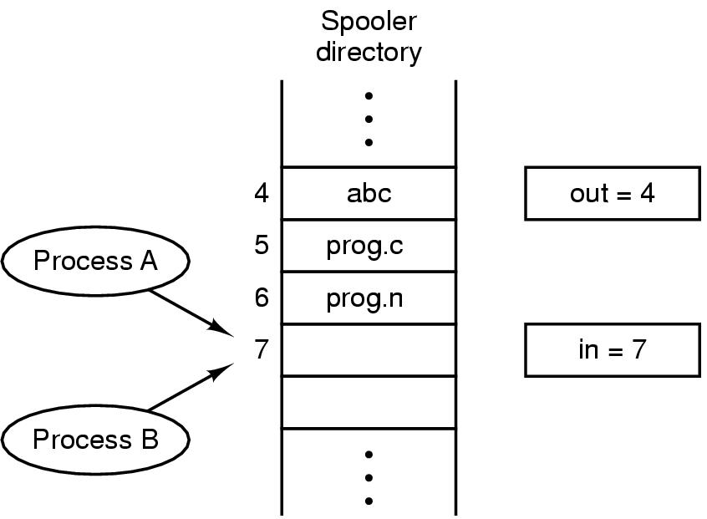
Race Condition
The situation where several processes access and manipulate shared data concurrently. The final value of the shared data depends upon which process finishes last.
A race condition is an undesirable situation that occurs when a device or system attempts to perform two or more operations at the same time.
But, because of the nature of the device or system, the operations must be done in the proper sequence to be done correctly.
To prevent race conditions, concurrent processes must be synchronized.
Print spooler directory example :
Two processes want to access shared memory at the same time.

Slide 8
Example of Race Condition
Process A
next_free_slot = in
Write file name at slot (7)
next_free_slot += 1
in = next_free_slot (8)
Context Switch
Process B
next_free_slot = in
Write file name at slot (8)
next_free_slot += 1
in = next_free_slot (9)
Process A
next_free_slot = in (7)
Context Switch
Process B
next_free_slot = in (7)
Write file name at slot (7)
next_free_slot += 1
in = next_free_slot (8)
Context Switch
Process A
Write file name at slot (7)
next_free_slot += 1
in = next_free_slot (8)
Race Condition

Slide 9
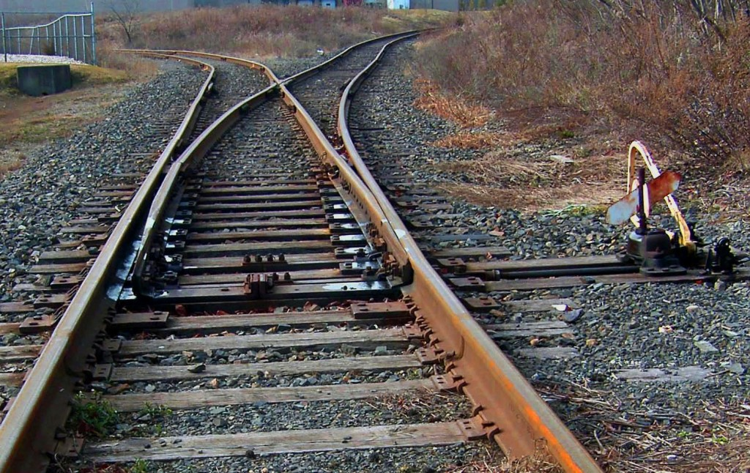

Critical Section
Critical Section: The part of program where the shared resource is accessed is called critical section or critical region.
A enters in critical region
A leaves critical region
Process A
B attempt to enter
B enters in critical region
B leaves critical region
Process B
T1
T2
B Blocked
T3
T4

Slide 10
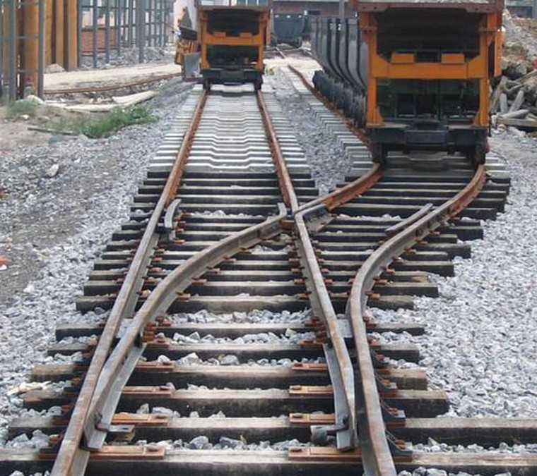

Mutual Exclusion
Mutual Exclusion: Way of making sure that if one process is using a shared variable or file; the other process will be excluded (stopped) from doing the same thing.

Slide 11




Solving Critical-Section Problem
Any good solution to the problem must satisfy following four conditions:
Mutual Exclusion
No two processes may be simultaneously inside the same critical section.
Bounded Waiting
No process should have to wait forever to enter a critical section.
Progress
No process running outside its critical region may block other processes.
Arbitrary Speed
No assumption can be made about the relative speed of different processes (though all processes have a non-zero speed).

Slide 12
Mutual exclusion with busy waiting
Section - 2

Slide 13
Mutual exclusion with busy waiting
Mechanisms for achieving mutual exclusion with busy waiting
Disabling interrupts (Hardware approach)
Shared lock variable (Software approach)
Strict alteration (Software approach)
TSL (Test and Set Lock) instruction (Hardware approach)
Exchange instruction (Hardware approach)
Dekker’s solution (Software approach)
Peterson’s solution (Software approach)

Slide 14





Real life example to explain mechanisms for achieving mutual exclusion with busy waiting

Slide 15
Disabling interrupts (Hardware approach)
Section – 2.1

Slide 16


Disabling interrupts (Hardware approach)
while (true)
{
< disable interrupts >;
< critical section >;
< enable interrupts >;
< remainder section >;
}
< critical section >
< remainder section >
< disable interrupts >
< enable interrupts >
Process A
Process B
T1
T3
T4

Slide 17
Problems in Disabling interrupts (Hardware approach)
Unattractive or unwise to give user processes the power to turn off interrupts.
What if one of the process did it (disable interrupt) and never turned them on (enable interrupt) again? That could be the end of the system.
If the system is a multiprocessor, with two or more CPUs, disabling interrupts affects only the CPU that executed the disable instruction. The other ones will continue running and can access the shared memory.

Slide 18
Shared lock variable (Software approach)
Section – 2.2

Slide 19
Shared lock variable (Software approach)
A shared variable lock having value 0 or 1.
Before entering into critical region a process checks a shared variable lock’s value.
If the value of lock is 0 then set it to 1 before entering the critical section and enters into critical section and set it to 0 immediately after leaving the critical section.
If the value of lock is 1 then wait until it becomes 0 by some other process which is in critical section.

Slide 20


Shared lock variable (Software approach)
Problem:
If process-A sees the value of lock variable 0 and before it can set it to 1 context switch occurs.
Now process-B runs and finds value of lock variable 0, so it sets value to 1, enters critical region.
At some point of time process-A resumes, sets the value of lock variable to 1, enters critical region.
Now two processes are in their critical regions accessing the same shared memory, which violates the mutual exclusion condition.
while (true)
{ < set shared variable to 1 >;
< critical section >;
< set shared variable to 0 >;
< remainder section >;
}
< critical section >
< remainder section >
< set lock to 1 >
< set lock to 0 >
Process A
Process B
T1
T3
T4

Slide 21
Strict alteration (Software approach)
Section – 2.3

Slide 22
Strict alteration (Software approach)
Integer variable 'turn' keeps track of whose turn is to enter the critical section.
Initially turn=0. Process 0 inspects turn, finds it to be 0, and enters in its critical section.
Process 1 also finds it to be 0 and therefore sits in a loop continually testing 'turn' to see when it becomes 1.
Continuously testing a variable waiting for some event to appear is called the busy waiting.
When process 0 exits from critical region it sets turn to 1 and now process 1 can find it to be 1 and enters in to critical region.
In this way, both the processes get alternate turn to enter in critical region.

Slide 23
Strict alteration (Software approach)
Process 0
while (TRUE)
{
while (turn != 0) /* loop */ ;
critical_region();
turn = 1;
noncritical_region();
}
Process 1
while (TRUE)
{
while (turn != 1) /* loop */ ;
critical_region();
turn = 0;
noncritical_region();
}
0
0
0
1
0
0
0 enters in critical region
0 leaves critical region
Process 0
1 attempt to enter
1 enters in critical region
1 leaves critical region
1 attempt to enter
Process 1
T1
T2
1 Busy Wait
T3
T4
T5
1 Busy Wait

Slide 24
Disadvantages of Strict alteration (Software approach)
Taking turns is not a good idea when one of the processes is much slower than the other.
Consider the following situation for two processes P0 and P1.
P0 leaves its critical region, set turn to 1, enters non critical region.
P1 enters and finishes its critical region, set turn to 0.
Now both P0 and P1 in non-critical region.
P0 finishes non critical region, enters critical region again, and leaves this region, set turn to 1.
P0 and P1 are now in non-critical region.
0
0
0
1
0
0
1
0 enters in critical region
0 leaves critical region
Process 0
1 attempt to enter
1 enters in critical region
1 leaves critical region
Process 1
T1
T2
1 Busy Wait
T3
T4
T5
T6
T7

Slide 25
Disadvantages of Strict alteration (Software approach)
Taking turns is not a good idea when one of the processes is much slower than the other.
Consider the following situation for two processes P0 and P1.
P0 finishes non critical region but cannot enter its critical region because turn = 1 and it is turn of P1 to enter the critical section.
Hence, P0 will be blocked by a process P1 which is not in critical region. This violates one of the conditions of mutual exclusion.
It wastes CPU time, so we should avoid busy waiting as much as we can.
0
0
0
1
0
0
1
0 attempt to enter
0 enters in critical region
0 leaves critical region
Process 0
1 attempt to enter
1 enters in critical region
1 leaves critical region
1 Busy Wait
Process 1
T1
T2
1 Busy Wait
T3
T4
T5
T6
T7

Slide 26
TSL (Test and Set Lock) instruction (Hardware approach)
Section – 2.4

Slide 27
TSL (Test and Set Lock) instruction (Hardware approach)
Algorithm
enter_region: (Before entering its critical region, process calls enter_region)
TSL REGISTER, LOCK |copy lock variable to register set lock to 1
CMP REGISTER, #0 |was register variable 0?
JNE enter_region |if it was nonzero, lock was set, so loop
RET |return to caller: critical region entered
leave_region: (When process wants to leave critical region, process calls leave_region)
MOVE LOCK, #0 |store 0 in lock variable
RET |return to caller
Register
0
Process 0
Process 1
T1
T2
T3

Slide 28
TSL (Test and Set Lock) instruction (Hardware approach)
Test and Set Lock Instruction
TSL REGISTER, LOCK
It reads the contents of the memory word lock into register RX and then stores a nonzero value at the memory address lock.
The operations of reading the word and storing into it are guaranteed to be indivisible—no other processor can access the memory word until the instruction is finished.
The CPU executing the TSL instruction locks the memory bus to prohibit other CPUs from accessing memory until it is done.
Register
0
Process 0
Process 1
T1
T2
T3

Slide 29
Exchange instruction (Hardware approach)
Section – 2.5

Slide 30
Exchange instruction (Hardware approach)
Algorithm
enter_region: (Before entering its critical region, process calls enter_region)
MOVE REGISTER, #1 |put 1 in the register
XCHG REGISTER ,LOCK |swap content of register & lock variable
CMP REGISTER, #0 |was register variable 0?
JNE enter_region |if it was nonzero, lock was set, so loop
RET |return to caller: critical region entered
leave_region: (When process wants to leave critical region, process calls leave_region)
MOVE LOCK, #0 |store 0 in lock variable
RET |return to caller

Slide 31
Dekker’s solution (Software approach)
Section – 2.6

Slide 32
Dekker’s solution (Software approach)
Algorithm
variables
wants_to_enter [2] //array of 2 booleans
turn //integer
wants_to_enter[0] ← false
wants_to_enter[1] ← false
turn ← 0 // or 1
P0
P1
P0
P1
0 | 0
0

Slide 33
Dekker’s solution (Software approach)
Process 0
wants_to_enter[0] ← true
while (wants_to_enter[1])
{if (turn == 1)
{wants_to_enter[0] ← false
while (turn == 1)
{// busy wait}
wants_to_enter[0] ← true
}
}
// critical section
...
turn ← 1
wants_to_enter[0] ← false
// remainder section
P0
P1
Process 1
wants_to_enter[1] ← true
while (wants_to_enter[0])
{if (turn == 0)
{wants_to_enter[1] ← false
while (turn == 0)
{// busy wait}
wants_to_enter[1] ← true
}
}
// critical section
...
turn ← 0
wants_to_enter[1] ← false
// remainder section
0 | 0
1 | 0
1
P0
P1
0 | 0

Slide 34
Dekker’s solution (Software approach)
Process 0
wants_to_enter[0] ← true
while (wants_to_enter[1])
{if (turn == 1)
{wants_to_enter[0] ← false
while (turn == 1)
{// busy wait}
wants_to_enter[0] ← true
}
}
// critical section
...
turn ← 1
wants_to_enter[0] ← false
// remainder section
P0
P1
Process 1
wants_to_enter[1] ← true
while (wants_to_enter[0])
{if (turn == 0)
{wants_to_enter[1] ← false
while (turn == 0)
{// busy wait}
wants_to_enter[1] ← true
}
}
// critical section
...
turn ← 0
wants_to_enter[1] ← false
// remainder section
0 | 1
1 | 1
1
0 | 1
1
1 | 1

Slide 35
Peterson’s solution (Software approach)
Section – 2.7

Slide 36
Peterson’s solution (Software approach)
#define FALSE 0
#define TRUE 1
#define N 2 //number of processes
int turn; //whose turn is it?
int interested[N]; //all values initially 0 (FALSE)
void enter_region(int process)
{
int other; // number of the other process
other = 1 - process; // the opposite process
interested[process] = TRUE; // this process is interested
turn = process; // set flag
while(turn == process && interested[other] == TRUE); // wait
}
void leave_region(int process)
{
interested[process] = FALSE; // process leaves critical region
}
0
1
P0
P1
P0
P1
0 | 0
1 | 0
1
0
1 | 0
1 | 1
0
1
0 | 1

Slide 37




Priority inversion problem
Priority inversion means the execution of a high priority process/thread is blocked by a lower priority process/thread.
Consider a computer with two processes, H having high priority and L having low priority.
The scheduling rules are such that H runs first then L will run.
At a certain moment, L is in critical region and H becomes ready to run (e.g. I/O operation complete).
H now begins busy waiting and waits until L will exit from critical region.
But H has highest priority than L so CPU
is switched from L to H.
Now L will never be scheduled (get CPU) until
H is running so L will never get chance to
leave the critical region so H loops forever.
This situation is called priority inversion problem.
L
H

Slide 38
Mutual Exclusion with Busy Waiting
Disabling Interrupts
is not appropriate as a general mutual exclusion mechanism for user processes
Lock Variables
contains exactly the same fatal flaw that we saw in the spooler directory
Strict Alternation
process running outside its critical region blocks other processes.
Peterson's Solution
The TSL/XCHG instruction
Both Peterson’s solution and the solutions using TSL or XCHG are correct.
Limitations:
Busy Waiting: this approach waste CPU time
Priority Inversion Problem: a low-priority process blocks a higher-priority one

Slide 39

Busy Waiting (Sleep and Wakeup)
Peterson’s solution and solution using TSL and XCHG have the limitation of requiring busy waiting.
when a processes wants to enter in its critical section, it checks to see if the entry is allowed.
If it is not allowed, the process goes into a loop and waits (i.e., start busy waiting) until it is allowed to enter.
This approach waste CPU-time.
But we have interprocess communication primitives (the pair of sleep & wakeup).
Sleep: It is a system call that causes the caller to be blocked (suspended) until some other process wakes it up.
Wakeup: It is a system call that wakes up the process.
Both 'sleep' and 'wakeup' system calls have one parameter that represents a memory address used to match up 'sleeps' and 'wakeups'.

Slide 40
The Producer Consumer Problem
Section - 3

Slide 41


The Producer Consumer Problem
It is multi-process synchronization problem.
It is also known as bounded buffer problem.
This problem describes two processes producer and consumer, who share common, fixed size buffer.
Producer process
Produce some information and put it into buffer
Consumer process
Consume this information (remove it from the buffer)
Producer
Buffer
Consumer

Slide 42
What Producer Consumer problem is?
Buffer is empty
Producer want to produce
Consumer want to consume
Buffer is full
Producer want to produce
Consumer want to consume
Buffer is partial filled
Producer want to produce
Consumer want to consume
√
X
X
Producer
Buffer
Consumer
√
√
√

Slide 43
Producer Consumer problem using Sleep & Wakeup
#define N 4
int count=0;
void producer (void)
{ int item;
while (true)
{ item=produce_item();
if (count==N) sleep();
insert_item(item);
count=count+1;
if(count==1) wakeup(consumer);
}
}
count
0
1
item
Item 1
Producer
Buffer
Consumer
1
2
3
4

Slide 44
Producer Consumer problem using Sleep & Wakeup
void consumer (void)
{ int item;
while (true)
{ if (count==0) sleep();
item=remove_item();
count=count-1;
if(count==N-1)
wakeup(producer);
consume_item(item);
}
}
count
0
1
item
Producer
Buffer
Consumer
1
Item 1
2
3
4

Slide 45

Problem in Sleep & Wakeup
Problem with this solution is that it contains a race condition that can lead to a deadlock. (How???)
Producer
Consumer
#define N 4
int count=0;
void producer (void)
{ int item;
while (true)
{ item=produce_item();
if (count==N) sleep();
insert_item(item);
count=count+1;
if(count==1) wakeup(consumer);
}
}
void consumer (void)
{ int item;
while (true)
{ if (count==0) sleep();
item=remove_item();
count=count-1;
if(count==N-1)
wakeup(producer);
consume_item(item);
}
}
Context
Switching
count
0
1
item
Item 1
Buffer
1
2
Item 2
3
Item 3
4
Item 4
Wakeup
Signal

Slide 46
Problem in Sleep & Wakeup
The consumer has just read the variable count, noticed it's zero and is just about to move inside the if block.
Just before calling sleep, the consumer is suspended and the producer is resumed.
The producer creates an item, puts it into the buffer, and increases count.
Because the buffer was empty prior to the last addition, the producer tries to wake up the consumer.
Unfortunately the consumer wasn't yet sleeping, and the wakeup call is lost.
When the consumer resumes, it goes to sleep and will never be awakened again. This is because the consumer is only awakened by the producer when count is equal to 1.
The producer will loop until the buffer is full, after which it will also go to sleep.
Finally, both the processes will sleep forever. This solution therefore is unsatisfactory.

Slide 47
Semaphore
Section - 4

Slide 48
Semaphore
A semaphore is a variable that provides an abstraction for controlling the access of a shared resource by multiple processes in a parallel programming environment.
There are 2 types of semaphores:
Binary semaphores :-
Binary semaphores can take only 2 values (0/1).
Binary semaphores have 2 methods associated with it (up, down / lock, unlock).
They are used to acquire locks.
Counting semaphores :-
Counting semaphore can have possible values more than two.

Slide 49
Semaphore
We want functions insert _item and remove_item such that the following hold:
Mutually exclusive access to buffer: At any time only one process should be executing (either insert_item or remove_item).
No buffer overflow: A process executes insert_item only when the buffer is not full (i.e., the process is blocked if the buffer is full).
No buffer underflow: A process executes remove_item only when the buffer is not empty (i.e., the process is blocked if the buffer is empty).
No busy waiting.
No producer starvation: A process does not wait forever at insert_item() provided the buffer repeatedly becomes full.
No consumer starvation: A process does not wait forever at remove_item() provided the buffer repeatedly becomes empty.

Slide 50
Operations on Semaphore
Wait(): a process performs a wait operation to tell the semaphore that it wants exclusive access to the shared resource.
If the semaphore is empty, then the semaphore enters the full state and allows the process to continue its execution immediately.
If the semaphore is full, then the semaphore suspends the process (and remembers that the process is suspended).
Signal(): a process performs a signal operation to inform the semaphore that it is finished using the shared resource.
If there are processes suspended on the semaphore, the semaphore wakes one of the up.
If there are no processes suspended on the semaphore, the semaphore goes into the empty state.

Slide 51
Producer Consumer problem using Semaphore
#define N 4
typedef int semaphore;
semaphore mutex=1;
semaphore empty=N;
semaphore full=0;
void producer (void)
{ int item;
while (true)
{ item=produce_item();
down(&empty);
down(&mutex);
insert_item(item);
up(&mutex);
up(&full); }
}
mutex
0
1
empty
4
3
full
0
1
item
Item 1
Producer
Buffer
Consumer
1
2
3
4

Slide 52
Producer Consumer problem using Semaphore
void consumer (void)
{ int item;
while (true)
{
down(&full);
down(&mutex);
item=remove_item(item);
up(&mutex);
up(&empty);
consume_item(item);
}
}
mutex
0
1
empty
4
3
full
0
1
item
Producer
Buffer
Consumer
1
Item 1
2
3
4

Slide 53
Classical IPC Problems Readers & Writer Problem
Section – 5.1

Slide 54
Readers & Writer Problem
In the readers and writers problem, many competing processes are wishing to perform reading and writing operations in a database.
It is acceptable to have multiple processes reading the database at the same time, but if one process is updating (writing) the database, no other processes may have access to the database, not even readers.
Need to keep track of read of more than one process at a time
P1
P2
P3
P1
P2
P3
Read
X
Read
X
Read
Read
√
Read
√
3
Reader_count
Write
Write
Write
Write
Write
X
X
X
X
DATABASE
DATABASE

Slide 55
Readers & Writer Problem
typedef int semaphore;
semaphore mutex=1; //control access to reader count
semaphore db=1; //control access to database
int reader_count=0; //number of processes reading database

Slide 56
Readers & Writer Problem
void Reader (void)
{ while (true) {
down(&mutex); //gain access to reader count
reader_count=reader_count+1; //increment reader counter
if(reader_count==1) //if this is first process to read DB
down(&db) //prevent writer process to access DB
up(&mutex) //allow other process to access reader_count
read_database();
down(&mutex); //gain access to reader count
reader_count=reader_count-1; //decrement reader counter
if(reader_count==0) //if this is last process to read DB
up(&db) //leave the control of DB, allow writer process
up(&mutex) //allow other process to access reader_count
use_read_data(); } //use data read from DB (non-critical)
}

Slide 57
Readers & Writer Problem
void Writer (void)
{ while (true) {
create_data(); //create data to enter into DB (non-critical)
down(&db); //gain access to DB
write_db(); //write information to DB
up(&db); } //release exclusive access to DB
}

Slide 58
Classical IPC Problems Dinning Philosopher Problem
Section – 5.2

Slide 59
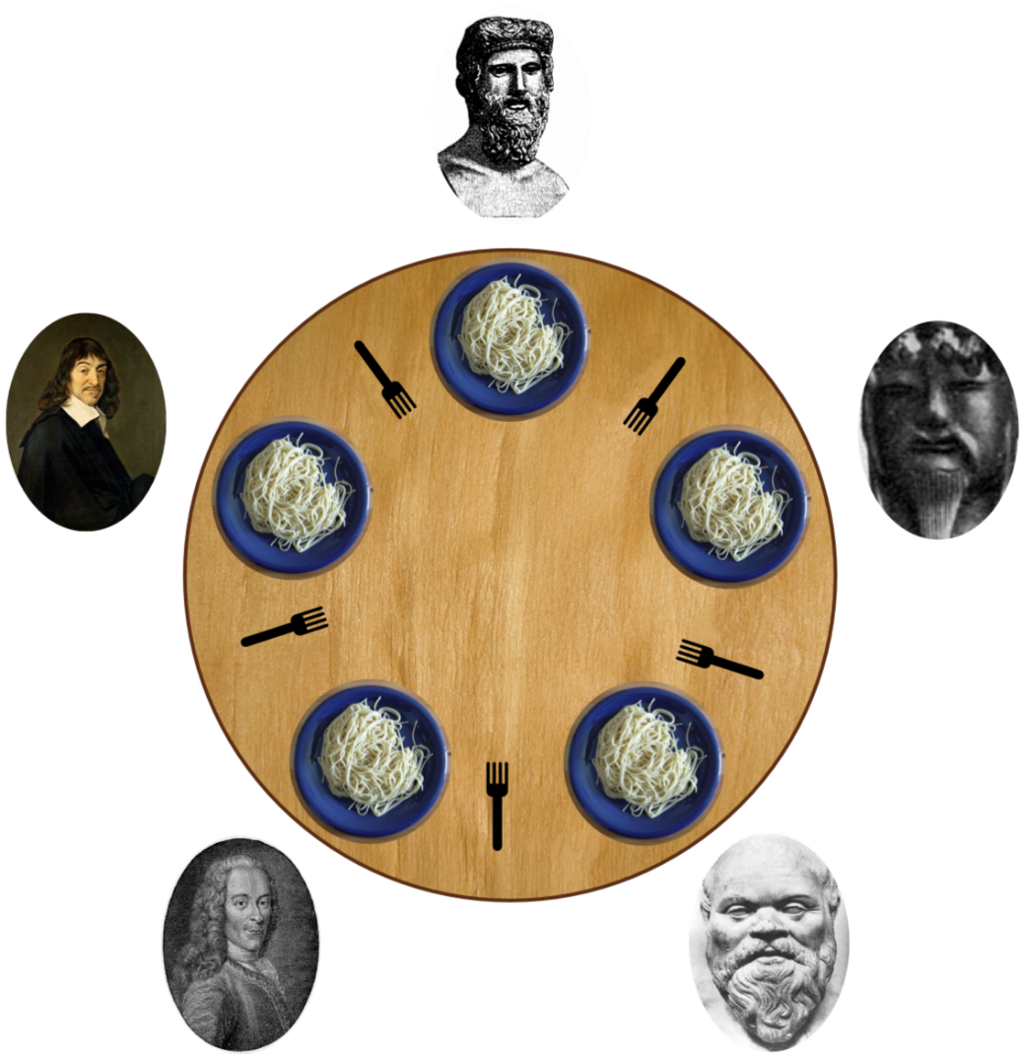
Dinning Philosopher Problem
In this problem 5 philosophers sitting at a round table doing 2 things eating and thinking.
While eating they are not thinking and while thinking they are not eating.
Each philosopher has plates that is total of 5 plates.
And there is a fork place between each pair of adjacent philosophers that is total of 5 forks.
Each philosopher needs 2 forks to eat and each philosopher can only use the forks on his immediate left and immediate right.

Slide 60
Dinning Philosopher Problem
#define N 5 //no. of philosophers
#define LEFT (i+N-1)%5 //no. of i’s left neighbor
#define RIGHT (i+1)%5 //no. of i’s right neighbor
#define THINKING 0 //Philosopher is thinking
#define HUNGRY 1 //Philosopher is trying to get forks
#define EATING 2 //Philosopher is eating
typedef int semaphore; //semaphore is special kind of int
int state[N]; //array to keep track of everyone’s state
semaphore mutex=1; //mutual exclusion for critical region
semaphore s[N]; //one semaphore per philosopher

Slide 61
Dinning Philosopher Problem
void take_forks (int i) //i: philosopher no, from 0 to N-1
{ down(&mutex); //enter critical region
state[i]=HUNGRY; //record fact that philosopher i is hungry
test(i); //try to acquire 2 forks
up(&mutex); //exit critical region
down(&s[i]); //block if forks were not acquired
}
void philosopher (int i) //i: philosopher no, from 0 to N-1
{
while (true)
{
think(); //philosopher is thinking
take_forks(i); //acquire two forks or block
eat(); //eating spaghetti
put_forks(i); //put both forks back on table
}
}
void test (i) //i: philosopher no, from 0 to N-1
{ if (state[i]==HUNGRY && state[LEFT]!=EATING && state[RIGHT]!=EATING)
{ state[i]=EATING;
up (&s[i]); }
}
void put_forks (int i) //i: philosopher no, from 0 to N-1
{ down(&mutex); //enter critical region
state[i]=THINKING; //philosopher has finished eating
test(LEFT); //see if left neighbor can now eat
test(RIGHT); // see if right neighbor can now eat
up(&mutex); // exit critical region
}

Slide 62
Monitor
Section – 6

Slide 63
Monitor
A higher-level synchronization primitive.
A monitor is a collection of procedures, variables, and data structures that are all grouped together in a special kind of module or package.
Processes may call the procedures in a monitor whenever they want to, but they cannot directly access the monitor’s internal data structures from procedures declared outside the monitor.
Monitors have an important property for achieving mutual exclusion: only one process can be active in a monitor at any instant.
When a process calls a monitor procedure, the first few instructions of the procedure will check to see if any other process is currently active within the monitor.
If so, the calling process will be suspended until the other process has left the monitor. If no other process is using the monitor, the calling process may enter.

Slide 64
Producer Consumer problem using Monitor
The solution proposes condition variables, along with two operations on them, wait and signal.
When a monitor procedure discovers that it cannot continue (e.g., the producer finds the buffer full), it does a wait on some condition variable, full.
This action causes the calling process to block. It also allows another process that had been previously prohibited from entering the monitor to enter now.
This other process the consumer, can wake up its sleeping partner by doing a signal on the condition variable that its partner is waiting on.
To avoid having two active processes in the monitor at the same time a signal statement may appear only as the final statement in a monitor procedure.
If a signal is done on a condition variable on which several processes are waiting, only one of them, determined by the system scheduler, is revived.

Slide 65
Producer Consumer problem using Monitor
monitor ProducerConsumer
condition full, empty;
integer count;
procedure producer;
begin
while true do
begin
item=produce_item;
ProducerConsumer.insert(item);
end;
end;
procedure insert (item:integer);
begin
if count=N then wait (full);
insert_item(item);
count=count+1;
if count=1 then signal (empty);
end;

Slide 66
Producer Consumer problem using Monitor
procedure consumer;
begin
while true do
begin
item=ProducerConsumer.remove;
Consume_insert(item);
end;
end;
function remove:integer;
begin
if count=0 then wait (empty);
remove=remove_item;
count=count-1;
if count=N-1 then signal (full);
end;
count=0;
end monitor;

Slide 67
Mutex
Section – 7

Slide 68
Mutex
Mutex is the short form for ‘Mutual Exclusion Object’.
A Mutex and the binary semaphore are essentially the same.
Both Mutex and the binary semaphore can take values: 0 or 1.
mutex_lock:
TSL REGISTER,MUTEX |copy Mutex to register and set Mutex to 1
CMP REGISTERS, #0 |was Mutex zero?
JZE ok |if it was zero, Mutex was unlocked, so return
CALL thread_yield |Mutex is busy; schedule another thread
JMP mutex_lock |try again later
ok: RET |return to caller; critical region entered
mutex_unlock:
MOVE MUTEX,#0 |store a 0 in Mutex
RET |return to caller

Slide 69
Pipes and Message Passing
Section – 8

Slide 70
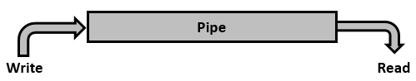
Pipes
Pipe is a communication medium between two or more related or interrelated processes usually between parent and child process.
Communication is achieved by one process write into the pipe and other process reads from the pipe.
It performs one-way communication only means we can use a pipe such that one process write into the pipe, and other process reads from the pipe.
It opens a pipe, which is an area of main memory that is treated as a “virtual file”.
It is bounded buffer means we can send only limited data through pipe.

Slide 71
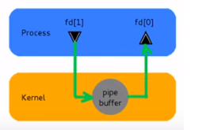
Pipes
Accessed by two associated file descriptors:
fd[0] for reading from pipe
fd[1] for writing into the pipe
This system call would create a pipe for one-way communication i.e., it creates two descriptors, first one is connected to read from the pipe and other one is connected to write into the pipe.
Descriptor pipedes[0] is for reading and pipedes[1] is for writing. Whatever is written into pipedes[1] can be read from pipedes[0].
This call would return zero on success and -1 in case of failure.
#include<unistd.h>
int pipe(int pipedes[2]);

Slide 72
Pipes
#include<unistd.h>
#include<fcntl.h>
#include<stdion.h>
char *message = “Hey how are you” /* Message created */
main ()
{
char buffer[1024]; /* Size of buffer is 1024 */
int fd[2]; /* Created array of size 2 for 2 process (file descriptor) */
pipe(fd); /* Created pipe; passed array (fd) in pipe system call */
if (fork() != 0) /* Parent code */
{ write (fd[1], message, strlen (message) + 1); }
else /* Child code */
{ read (fd[0], buffer, 1024);
printf (“Received from Parent %s\n”, buffer); }
}
Header files

Slide 73
Pipes
#include<unistd.h>
#include<fcntl.h>
#include<stdion.h>
char *message = “Hey how are you”
main ()
{
char buffer[1024];
int fd[2];
pipe(fd);
if (fork() != 0) /* Parent code */
{ write (fd[1], message,
strlen (message) + 1); }
else /* Child code */
{ read (fd[0], buffer, 1024);
printf (“Received from Parent %s\n”,
buffer); }
}
#include<unistd.h>
#include<fcntl.h>
#include<stdion.h>
char *message = “Hey how are you” main ()
{
char buffer[1024];
int fd[2];
pipe(fd);
if (fork != 0) /* Parent code */
{ write (fd[1], message,
strlen (message) + 1); }
else /* Child code */
{ read (fd[0], buffer, 1024);
printf (“Received from Parent %s\n”,
buffer); }
}
Parent process
Child process
pid = 3000
3000
0

Slide 74
Message Passing
This method will use two primitives
Send: It is used to send message.
Send (destination, &message)
In above syntax destination is the process to which sender want to send message and message is what the sender wants to send.
Receive: It is used to receive message.
Receive (source, &message)
In above syntax source is the process that has send message and message is what the sender has sent.

Slide 75
Producer Consumer problem using message passing
#define N 100 //number of slots in buffer
void producer (void)
{
int item;
message m; //message buffer
while (true)
{
item=produce_item(); //generate something to put in buffer
receive(consumer, &m); //wait for an empty to arrive
build_message(&m, item); //construct a message to send
send(consumer, &m); //send item to consumer
}
}
void consumer (void)
{
int item, i;
message m;
for (i=0; i<N; i++) send (producer, &m); //send N empties
while (true)
{
receive (producer, &m); //get message containing item
item=extract_item(&m); //extract item from message
send (producer, &m); //send back empty reply
consume_item (item); //do something with the item
}
}
Producer
Consumer
Message 1
Message 2
Producer
Message 3
Consumer

Slide 76
Producer Consumer problem using message passing
In this problem, an actual buffer does not exit. Instead, the producer and consumer pass messages to each other.
These messages can contain the items which, in the previous examples, were placed in a buffer.
In this example, a buffer size of three has been chosen.
The consumer begins the process by sending four empty messages to the producer.
The producer creates a new item for each empty message it receives, then it goes to sleep.
The producer will not create a new item unless it first receives an empty message.
The consumer waits for messages from the producer which contain the items.
Once consumer consumes an item, it sends an empty message to the producer.
Again, there is no real buffer, only a buffer size which dictates the number of items allowed to be produced.

Slide 77
Barrier and Signal
Section – 9

Slide 78
Barrier
In this mechanism some application are divided into phases and have that rule that no process may proceed into the next phase until all process completed in this phase and are ready to proceed to the next phase.
This behavior is achieved by placing barrier at the end of each phase.
When a process reaches the barrier, it is blocked until all processes have reach at the barrier.
There are four processes with a barrier.
A
B
Barrier
C
D
Time

Slide 79
Barrier
Processes A, B and D are completed and process C is still not completed so until process C will complete, process A, B and D will not start in next phase.
Once process C completes all the process start in next phase.
A
A
B
B
Barrier
Barrier
C
C
D
D
Time

Slide 80
Signal
Signals are software interrupts sent to a program to indicate that an important event has occurred.
When a signal is delivered to a process, the process will stop what its doing, either handle or ignore the signal.
Signals are similar to interrupts, the difference being that interrupts are mediated by the processor and handled by the kernel while signals are mediated by the kernel (possibly via system calls) and handled by processes.
The kernel may pass an interrupt as a signal to the process that caused it (examples are SIGSEGV, SIGBUS, SIGILL and SIGFPE).

Slide 81
Questions asked in GTU
Define following Terms: Mutual Exclusion, Critical Section, Race Condition
What is Semaphore? Give the implementation of Readers-Writers Problem using Semaphore
What is Semaphore? Give the implementation of Bounded Buffer Producer Consumer Problem using Semaphore.
Explain Dining philosopher solution using Semaphore.
What Critical section Problem and list the requirements to solve it. Write Peterson’s Solution for the same.
Write short note on message passing.
Explain monitor with algorithm.

Slide 82
Database Management Systems (DBMS)
GTU # 3130703
Prof. Firoz A Sherasiya
Computer Engineering Department
firoz.sherasiya@darshan.ac.in
9879879861

